Slide 1
Building Streaming Data Pipeline

Slide 2
Team Members -
Shubham Maurya
Sushant Mall
Vishwajeet Singh
Jaykishan Chaudhary
Mentor –
Mrs. Pushpa Singh

Slide 3


Slide 4
What is Big Data ?
Big
Larger volume than you’ve handled before
No litmus test
High value , under utilized
Data
Structured
Unstructured
Semi-Structured
Hadoop
Distributed file system
Distributed , batch computation

Slide 5
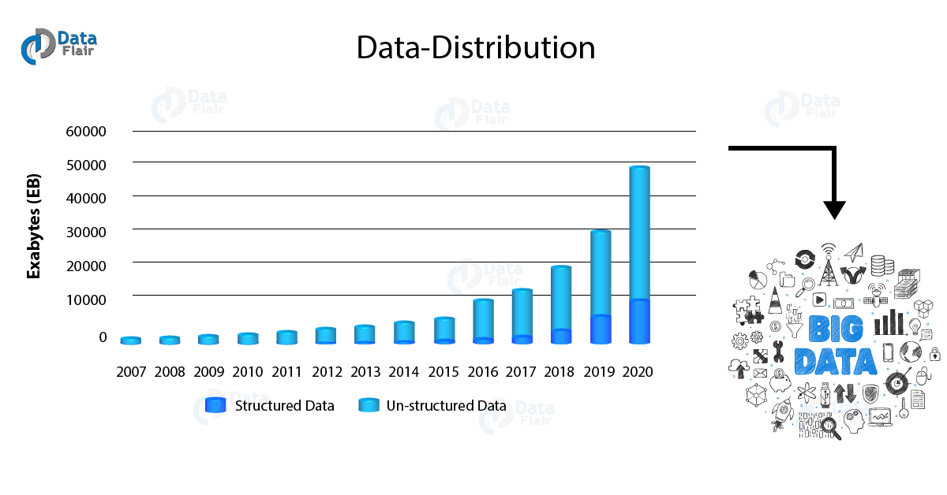
Exponential growth of Big Data -

Slide 6
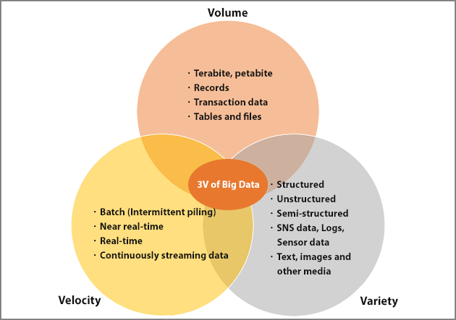
Understanding 3 v’s Of Big Data -

Slide 7
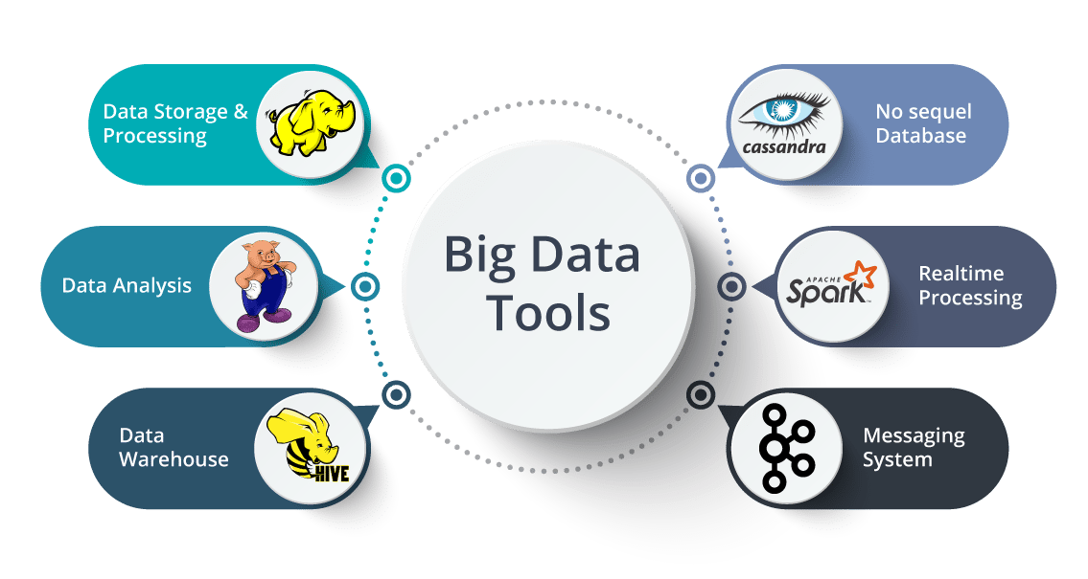
How to Handle Big Data -
Big Data can be handled by the following set of tools :

Slide 8
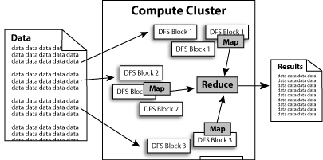
What is Hadoop ?
Hadoop is good in Task like :
Linear processing of huge data sets. Hadoop MapReduce allows parallel processing of huge amounts of data. It breaks a large chunk into smaller ones to be processed separately on different data nodes and automatically gathers the results across the multiple nodes to return a single result.

Slide 9
What is Spark ?
Spark is seen by techies in the industry as a more advanced product than Hadoop - it is newer, and designed to work by processing data "in memory“ . This means it transfers data from the physical, magnetic hard discs into far-faster electronic memory where processing can be carried out far more quickly - up to 100 times faster in some operations.
Spark framework is compatible to work with batch data as well as Real-time data.
Spark provides more API’s than Hadoop to work in various field of Data Science.

Slide 10
Why Spark & Why not Hadoop ?
Spark is a cluster-computing framework, Spark uses memory and can use disk for processing, whereas MapReduce is strictly disk-based. So as Spark works mostly on memory the data processing becomes faster as compared to Hadoop.
The biggest claim from Spark regarding speed is that it is able to "run programs up to 100x faster than Hadoop MapReduce in memory, or 10x faster on disk." Spark could make this claim because it does the processing in the main memory of the worker nodes and prevents the unnecessary I/O operations with the disks.

Slide 11

What is Hive ?
Created at Facebook
HiveQL
SQL like interface
Hive interpreter converts HiveQL to MapReduce code
Returns result to the client

Slide 12
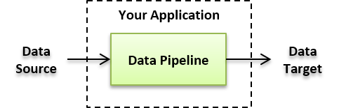
Data Pipeline -
“Data Pipeline" is a broader term that encompasses ETL as a subset. It refers to a system for moving data from one system to another. The data may or may not be transformed, and it may be processed in real time (or streaming) instead of batches. When the data is streamed, it is processed in a continuous flow which is useful for data that needs constant updating, such as a data from a sensor monitoring traffic. In addition, the data may not be loaded to a database or data warehouse. It might be loaded to any number of targets, such as an AWS bucket or a data lake.

Slide 13
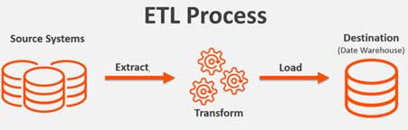
Existing Methodology -
ETL (EXTRACT , TRANSFORM , LOAD) :
In managing databases, extract, transform, load (ETL) refers to three separate functions combined into a single programming tool. First, the extract function reads data from a specified source database and extracts a desired subset of data. Next, the transform function works with the acquired data - using rules or lookup tables, or creating combinations with other data - to convert it to the desired state. Finally, the load function is used to write the resulting data to a target database, which may or may not previously exist.

Slide 14
What is Streaming Data ?
Data which are generated continuously through different sources in real-time. Such data should be processed incrementally using stream processing techniques.
Data Streaming can also be explained as the technology used to deliver content to devices over the internet , and it allows the user to access the content immediately , rather than waiting for it to be downloaded.

Slide 15
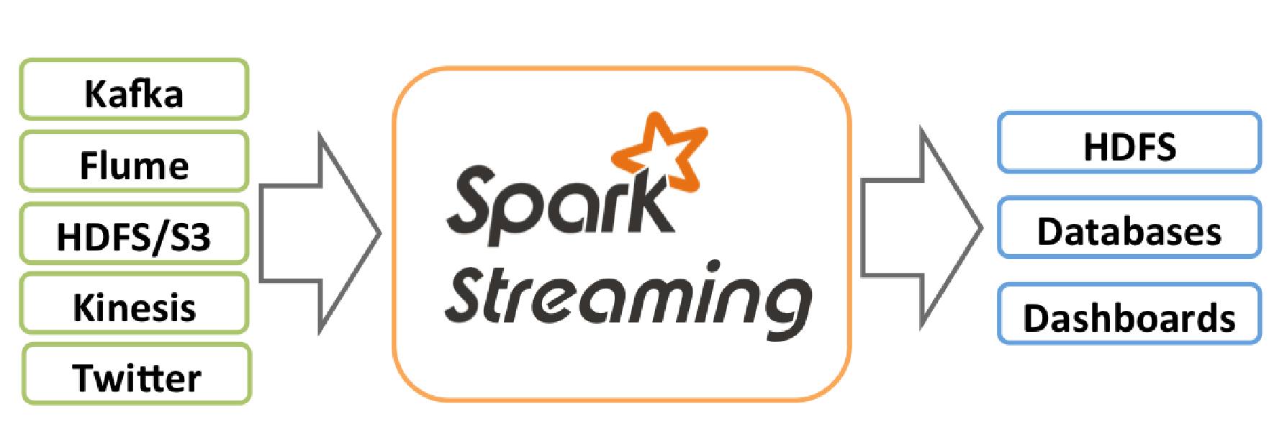
Architecture Of Streaming Data Pipeline -

Slide 16
Streaming Data Pipeline -
Steps in streaming Data Pipeline :-
Collection of data from various sources(LinkedIn, Twitter etc) using Kafka.
Processing real time data using Spark Streaming.
Storing result in (Hbase & HDFS).
Analyzing result using Hive.
Visualization & Presentation of analyzed result using Tableau &.

Slide 17

Analyzing Twitter
Social media popular with marketing teams
Twitter is an effective tool for promotion
Who is influential ?
Tweets
Followers
Retweets
Like e-mail forwarding
Which twitter user gets the most retweets ?
Who is influential in our industry ?

Slide 18
Why Twitter Data ?
Twitter is a gold mine of data. Unlike other social platforms, almost every user’s tweets are completely public and pullable . This is a huge plus if you’re trying to get a large amount of data to run analytics on. Twitter data is also specific. Twitter’s API allows you to do complex queries like pulling every tweet about a certain topic within the last twenty minutes or pull a certain user’s non-retweeted tweets.
A simple application of this could be analyzing how your company is received in the general public. You could collect the last 2,000 tweets that mention your company or any term you like and run a sentiment analysis algorithm over it.
We can also target users that specifically live in a certain location, which is known as spatial data. Another application of this could be to map the areas on the globe where your company has been mentioned the most.
As you can see, Twitter data can be a large door into the insights of the general public and how they receive a topic. That, combined with the openness and the generous rate limiting of Twitter’s API, can produce powerful results.

Slide 19
Installing Tweepy
Tweepy is an excellently supported tool for accessing the Twitter API . It supports Python 2.6 , 2.7 , 3.3 , 3.5 and 3.6 . There are couple of different ways to install Tweepy . The easiest way is using pip .
Using Pip –
Simply type pip install tweepy into your terminal .
Using GitHub –
You can follow the instruction on Tweepy’s GitHub repository . The basic steps are as follows :
git clone https://github.com/tweepy/tweepy.git cd tweepy python setup.py install
You can troubleshoot any installation issues there as well .

Slide 20
Authenticating ourselves
Now that we have the necessary tools ready, we can start coding! The baseline of each application we’ll build today requires using Tweepy to create an API object which we can call functions with. In order create the API object, however, we must first authenticate ourselves with our developer information.
First, let’s import Tweepy and add our own authentication information.
import tweepy consumer_key = "wXXXXXXXXXXXXXXXXXXXXXXX1" consumer_secret = “qXXXXXXXXXXXXXXXXXXXXXXXXXXXXXXXXXXXXXXXXXXXXXXXXXh" access_token = "9XXXXXXXX- XXXXXXXXXXXXXXXXXXXXXXXXXXXXXXXXXXXXXXXi" access_token_secret = "kXXXXXXXXXXXXXXXXXXXXXXXXXXXXXXXXXXXXXXXXXXXT“
In order to get these codes we have to follow certain steps .

Slide 21

Creating a Twitter application
Step 1 : Create a twitter application by signing in to www.developer.twitter.com

Slide 22
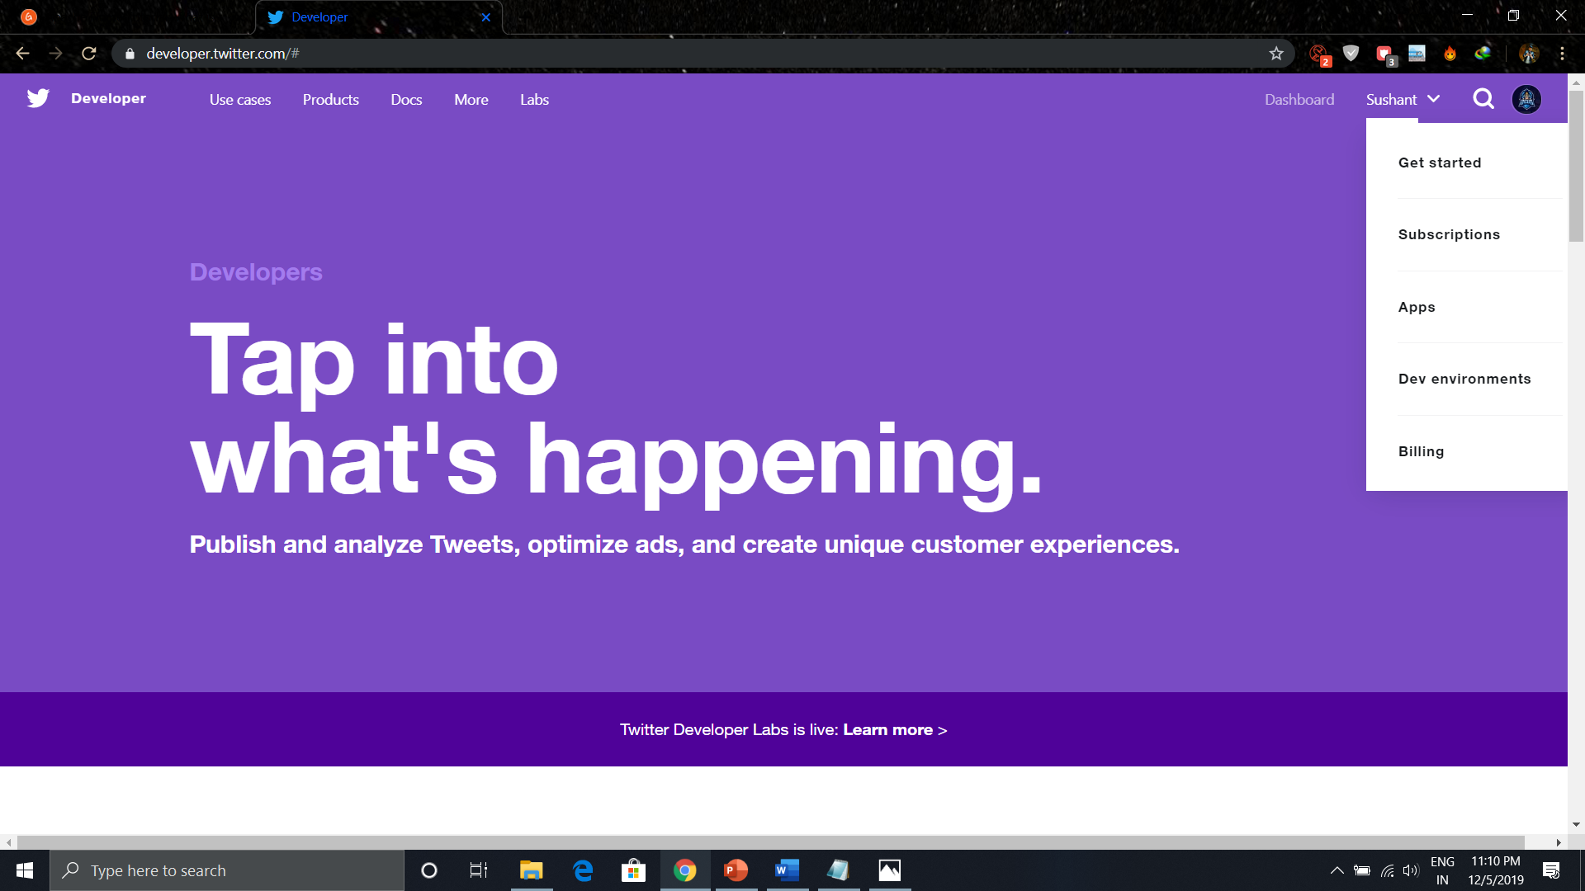
Step 2 : Go to “apps” (This option gets dropped down when profile name button at the top right corner is clicked).

Slide 23
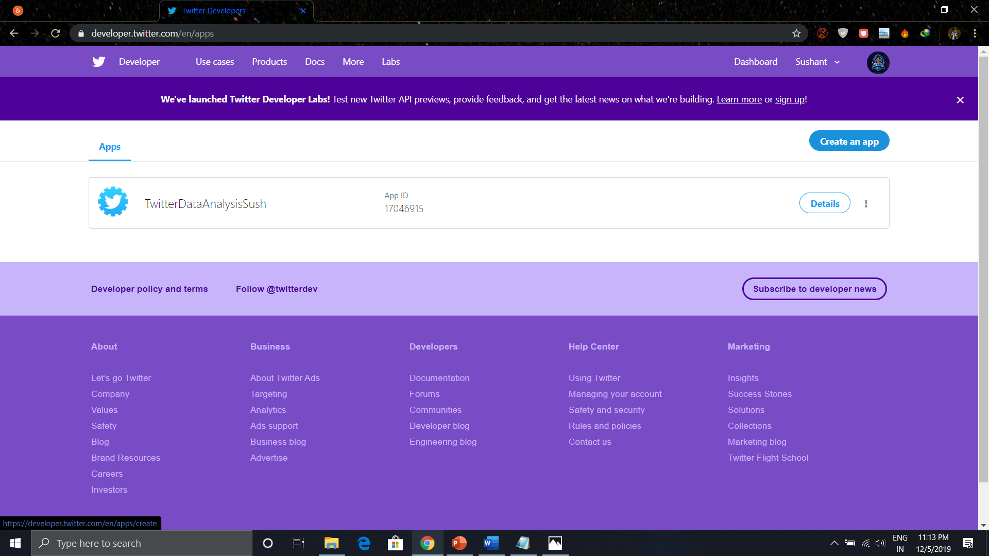
Step 3) Create a new application by clicking 'Create New App’

Slide 24
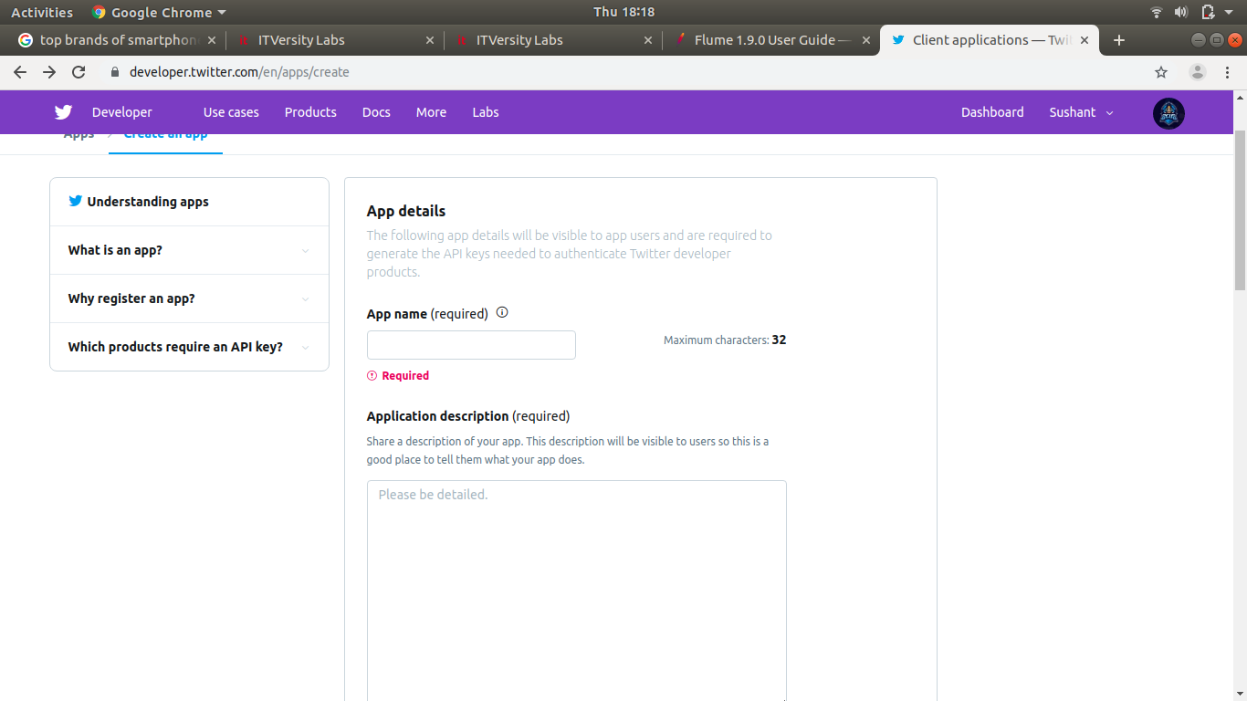
Step 4) Fill up application details by specifying the name of application, description, and website. You may refer to the notes given underneath each input box.

Slide 25
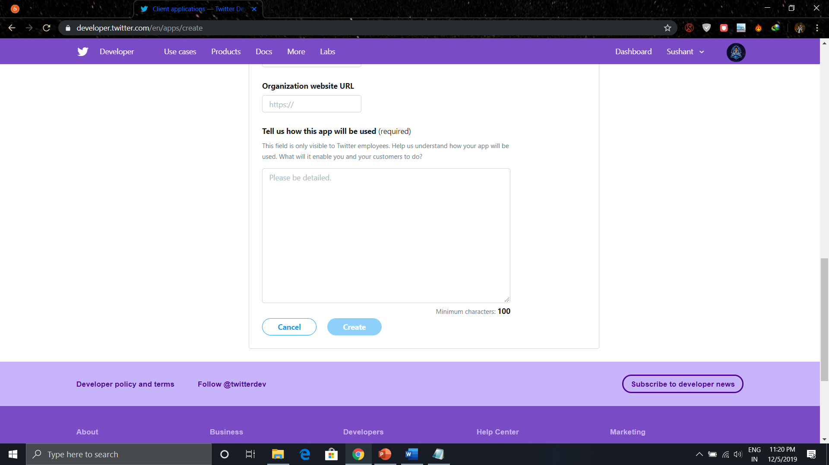
Step 5) Scroll down the page and accept terms by marking 'Yes, I agree' and click on button 'Create’

Slide 26
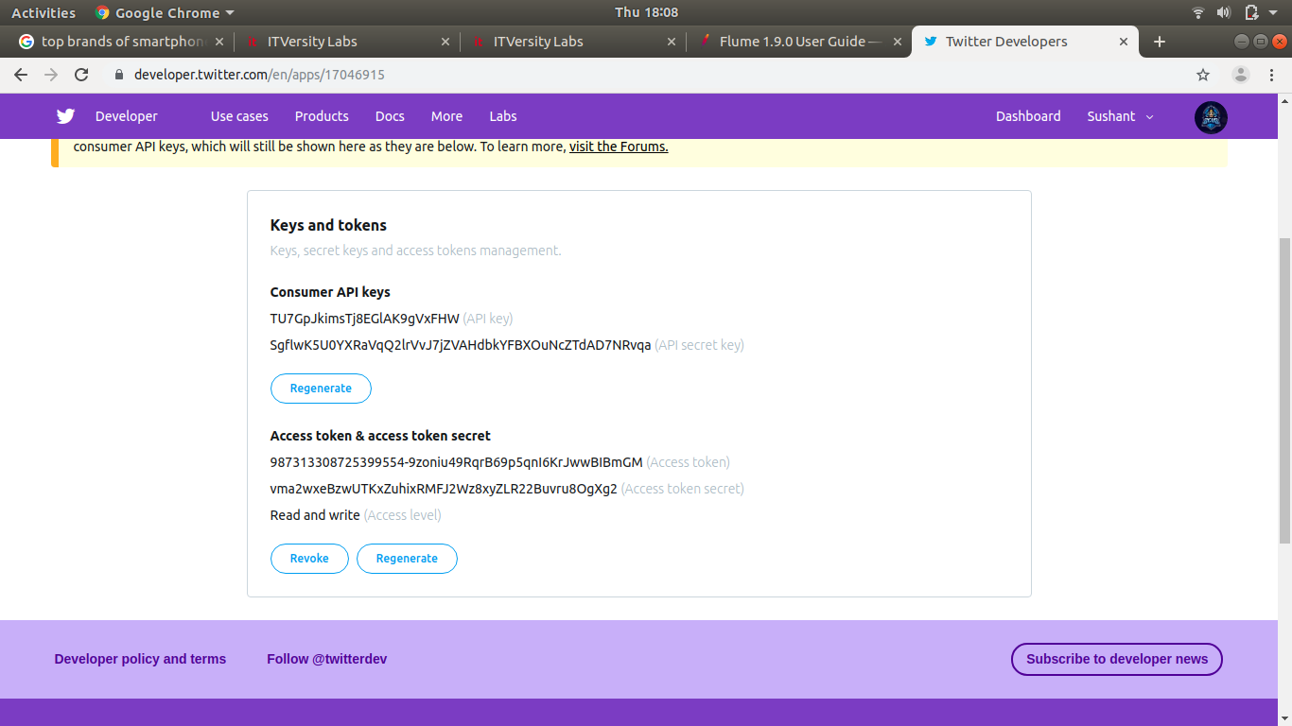
Step 6) On the window of a newly created application, go to the tab, 'API Keys' scroll down the page and click button 'Create my access token’.
We need to copy Consumer key, Consumer secret, Access token and Access token secret to updating 'twitter_4.conf'.

Slide 27
MODIFYING ‘ twitter_4.conf ’ FILE
Step 1) Open 'twitter_4.conf' in write mode and set values for below parameters-
sudo gedit flume.conf
Step 2) Copy the keys in the code.

Slide 28
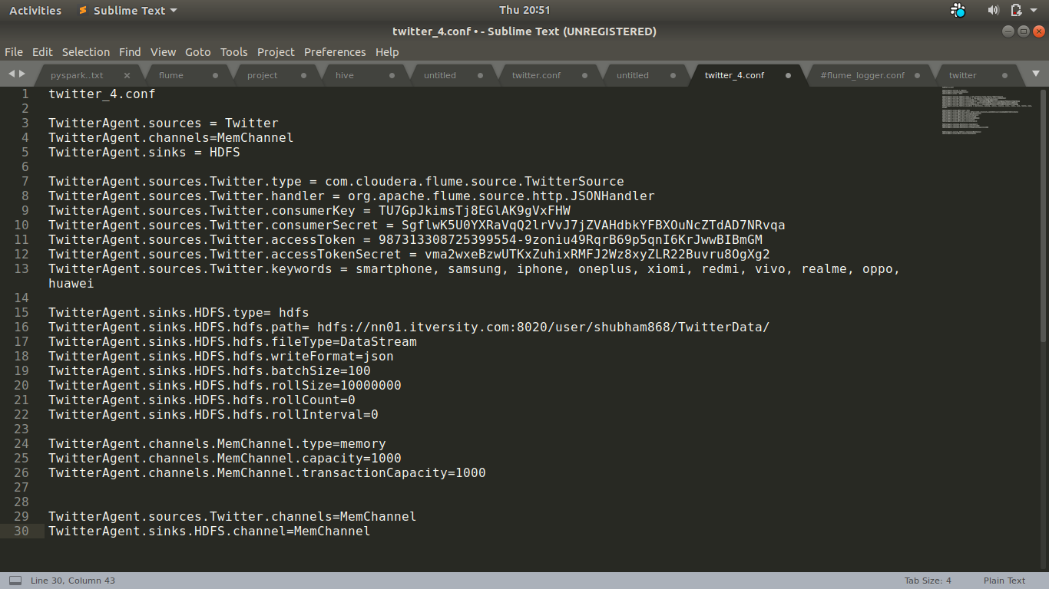
Step 3)The code after copying the keys looks like-

Slide 29
Step 4) Also, set TwitterAgent.sinks.HDFS.hdfs.path as below,
TwitterAgent.sinks.HDFS.hdfs.path = hdfs://<Host Name>:<Port Number>/<HDFS Home Directory>/flume/tweets/
To know <Host Name>, <Port Number> and <HDFS Home Directory> , see value of parameter 'fs.defaultFS' set in $HADOOP_HOME/etc/hadoop/core-site.xml
Step 5) In order to flush the data to HDFS, as an when it comes, delete below entry if it exists,
TwitterAgent.sinks.HDFS.hdfs.rollInterval = 600

Slide 30
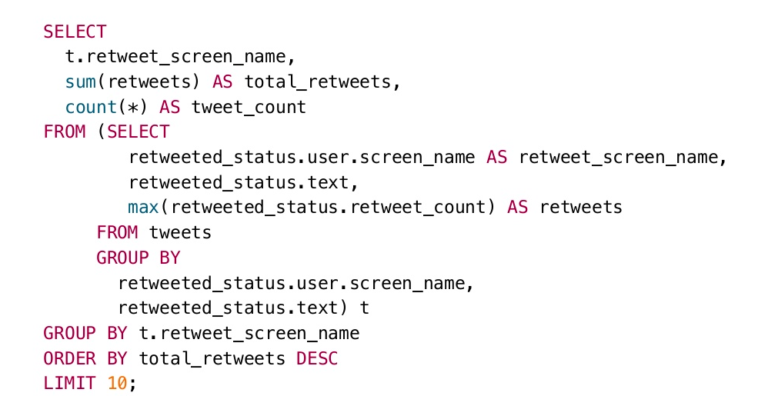
Checking total no. of Retweets

